Slide 1
Examining Anomaly Detection on Power Consumption Using Hidden Markov Model
CMPT 318 - Group 15
Term project

Slide 2
Topics
Feature Engineering
Principal Component Analysis
Feature Selection
Hidden Markov Model
Test and Training Sets
Model Training and Optimization
Model Evaluation
Anomaly Detection
Finding Deviation Threshold
Injecting Anomalies
Results

Slide 3




Feature Engineering (data cleaning)
Extracted numeric columns
Created a new DateTime column

Slide 4


Feature Engineering (data cleaning)
Spline interpolation of unknown points

Slide 5
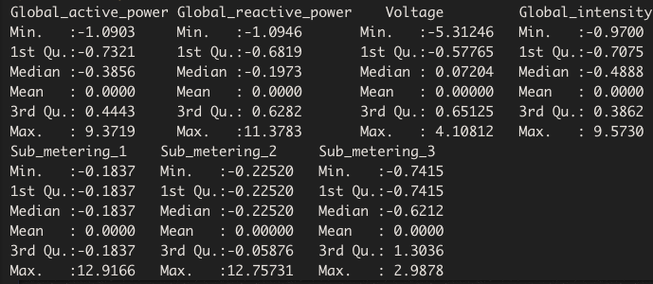
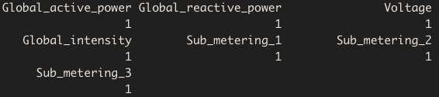
Feature Engineering (standardization)
Mean = 0
Standard deviation = 1
(X-μ)/σ

Slide 6
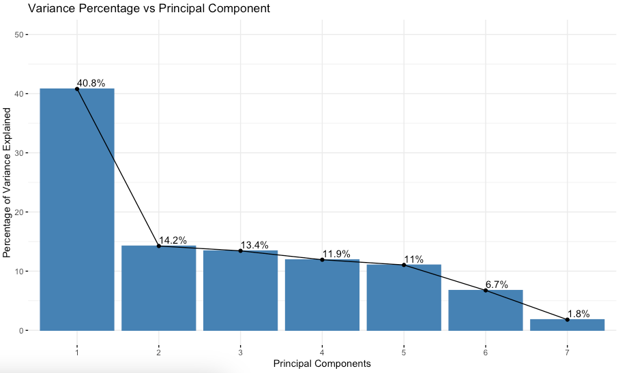
Feature Engineering (Principal Component Analysis)
Picking two major PCs

Slide 7
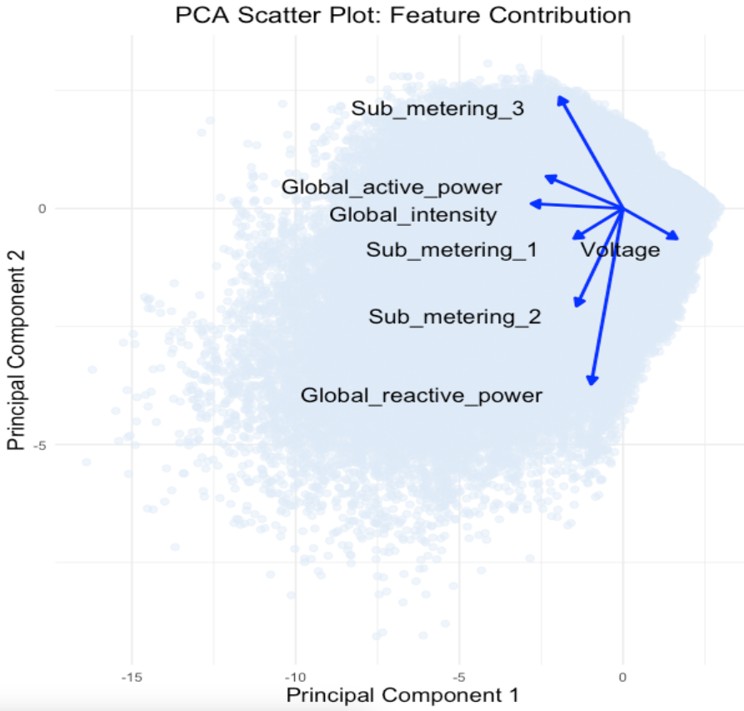
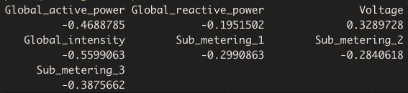

Feature Engineering (Principal Component Analysis)
Features:
(Global Intensity, Global_Active_power)
(Global Intensity, Voltage)

Slide 8
Hidden Markov Model (Testing and Training Data Division)
Focuses on specific times (Mondays, 9 AM to 12 PM) to identify meaningful patterns across three years
Uses the extract_time_window function to precisely isolate data segments from the specified time window
Years 2006 to 2008 used for model training, comprising 70% of the data
Year 2009 dedicated to testing, accounting for 30% of the data
A 70/30 split minimizes overfitting while providing substantial data for learning patterns

Slide 9
Hidden Markov Model (Testing and Training Data Code)
extract_time_window <- function(dataframe) { df_monday_9am_to_12pm <- dataframe %>% filter(weekdays(DateTime) == "Monday" & hour(DateTime) >= 9 & hour(DateTime) < 12) return(df_monday_9am_to_12pm) } df_scaled <- extract_time_window(df_scaled) train_data <- df_scaled %>% filter(Year <= 2008) test_data <- df_scaled %>% filter(Year == 2009) train_features <- train_data[, c("Global_intensity","Voltage")] test_features <- test_data[, c("Global_intensity","Voltage")]

Slide 10
Hidden Markov Model (Model Training)
Efficient HMM Training Using depmixS4 and Parallel Processing
Purpose and Tools
Utilizes the depmixS4 package for Hidden Markov Models (HMMs)
Accelerates the training process by leveraging multiple processor cores
Initialization and Data Handling
Configures initial states and EM algorithm parameters via em.control
Prepares lists for log-likelihoods and BIC values
Parallel Processing Setup
Implements parallel processing using doParallel and foreach.
Configures all available processor cores (minus one) with detectCores and makeCluster
Training and Metrics Computation
Executes model training in parallel
Computes and compiles metrics like log-likelihood and BIC for analysis
Concludes with stopCluster to terminate parallel setup

Slide 11
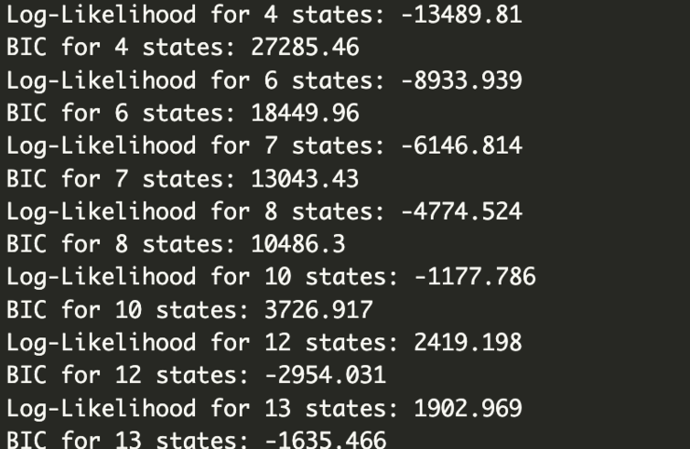
Hidden Markov Model (Training Code)
states_list <- c(4, 6, 7, 8, 10, 12, 13) em_ctrl <- em.control(maxit = 1000, tol = 1e-5) num_cores <- detectCores() cl <- makeCluster(num_cores) registerDoParallel(cl) results <- foreach(num_states = states_list, .packages = 'depmixS4') %dopar% { suppressMessages({ hmm_model <- depmix( response = list( Global_intensity ~ 1, Voltage ~ 1), data = train_features, nstates = num_states, family = list(gaussian(), gaussian()) ) set.seed(42) print(paste0("train model state = ", num_states)) fitted_model <- fit(hmm_model, ntimes = 10, verbose = FALSE, emcontrol = em_ctrl) log_likelihood <- logLik(fitted_model) bic_value <- BIC(fitted_model) list( num_states = num_states, log_likelihood = log_likelihood, bic_value = bic_value, model = fitted_model ) }) }

Slide 12
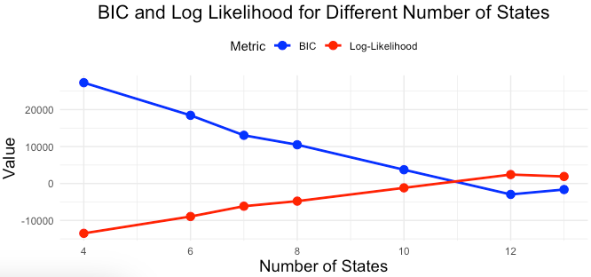
Log-likelihood and BIC trend in training

Slide 13
Hidden Markov Model (Model Optimization)
How We Improved the Model Efficiency?
Challenge in Model Training
As the number of states increased, computational speed significantly decreased
Initial Optimization Strategy
Limited the number of states to a maximum of 13 to enhance performance
Further Speed Improvement
Reduced the number of seeds in the set_seed() function to speed up computations
The set_seed() function ensures exact reproducibility of all calculations, vital for consistent results
Outcome
Substantial speed improvements in training process compared to earlier iterations

Slide 14
Hidden Markov Model (Model Evaluation and Prediction)
Purpose of Model Evaluation
Assess model performance on previously unseen data
Set aside 30% of data for testing to ensure robust evaluation
Evaluation Algorithm Development
Explanation of the steps taken to create an effective evaluation algorithm
Reference to code and visual aids (e.g., "See code block below and Figure 10")
Results and Analysis
Log-likelihoods: Training data shows “-6146.814” (normalized: “-0.3191492”), while testing data shows “-5609.337” (normalized: “-0.6492288”)
The results indicate a comparable level of effectiveness between training and testing datasets
Considerations
Slight reduction in likelihood for test data suggests the presence of unexpected patterns or anomalies

Slide 15
Hidden Markov Model (Model Evaluation Code)
test_model <- depmix( response = list(Global_intensity ~ 1, Voltage ~ 1), data = test_features, nstates = best_num_states, family = list(gaussian(), gaussian()) ) test_fitted <- setpars(test_model, getpars(best_model)) fb_test <- forwardbackward(test_fitted) test_log_likelihood <- fb_test$logLike cat("Log-Likelihood on Test Data:", test_log_likelihood, "\n")

Slide 16
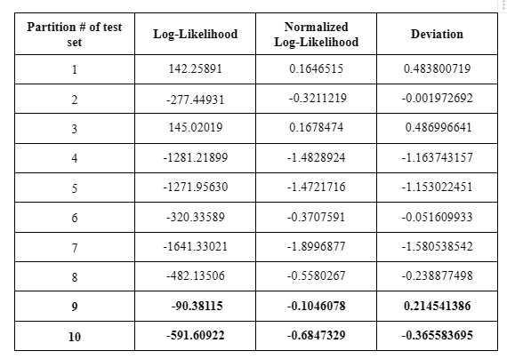
Anomaly Detection (Finding deviation threshold)
Step 1: Partition data
Step 2: Calculate Log-likelihood
Step 3: Normalize Log-Likelihood
Step 4: Calculate deviation
Step 5: Obtain Threshold

Slide 17
Anomaly Detection (Injecting Anomalies)
Method of Injecting Anomalies
Split test data into 3 groups
Inject 100 anomalies into each group
Test Results
Unmodified subset vs modified subset(injected anomalies)

Slide 18
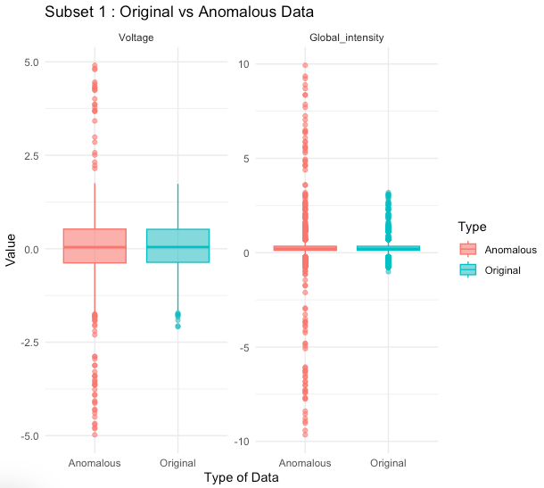
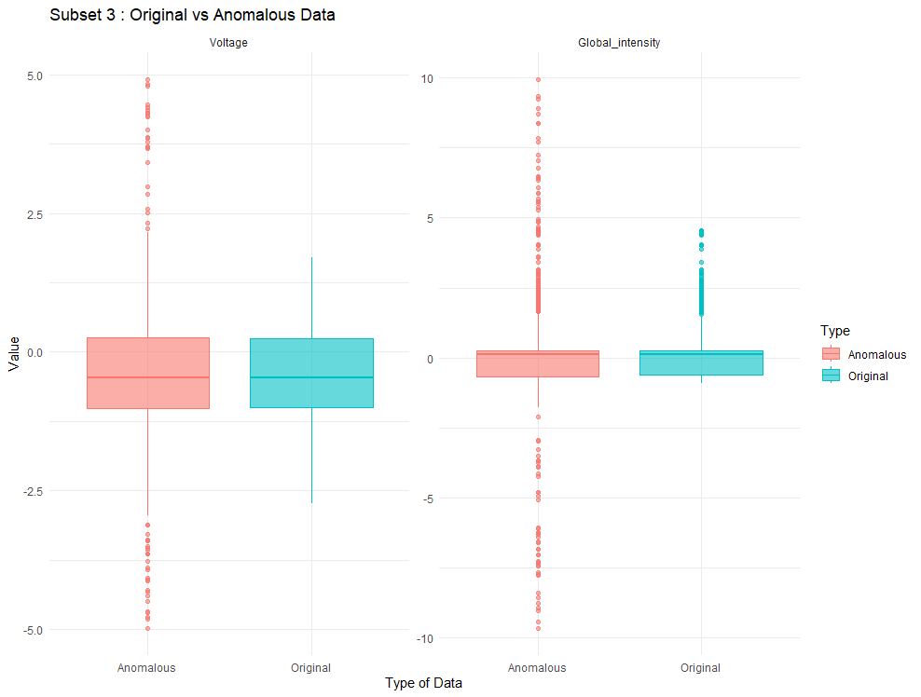
Anomaly Detection (Results)

Slide 19
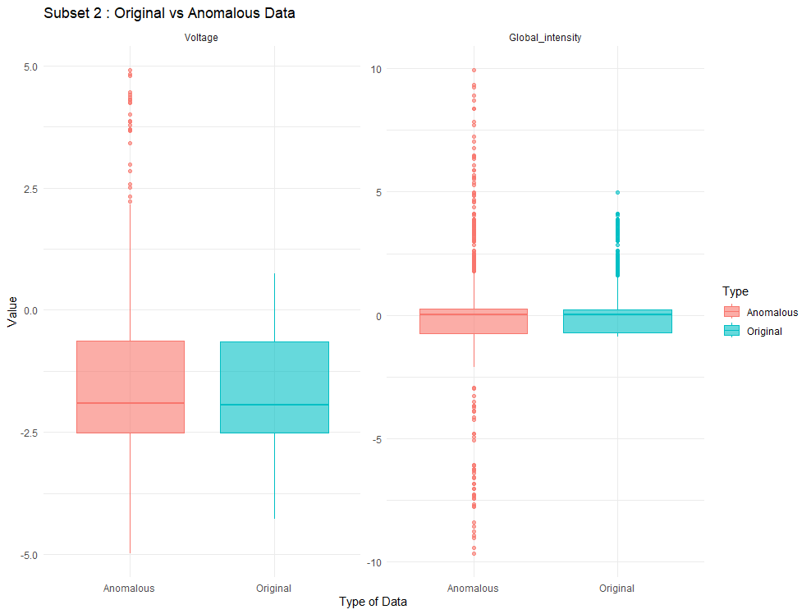
Anomaly Detection (Results)

Slide 20
Challenges and Lesson Learned
Feature selection using PCA
Selecting Optimal state number

